Slide 1
9/23 Updates
Christopher Thai

Slide 2
Changes to the scraper
Medium redundancy (used to be low redundancy)
Resulted in more hits per query protein on average
Starting queries from MEROPS – Clan PA

Slide 3
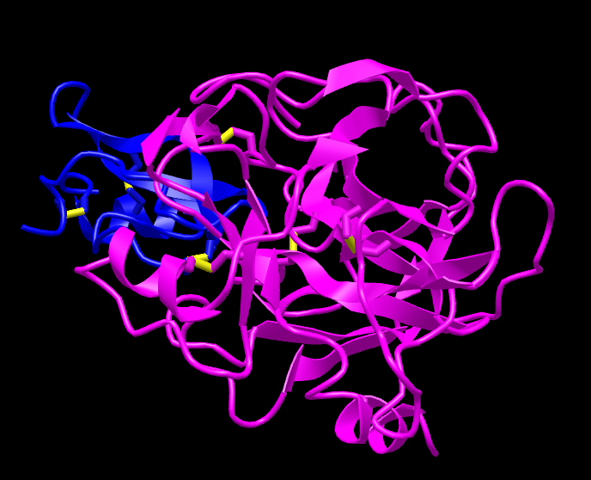
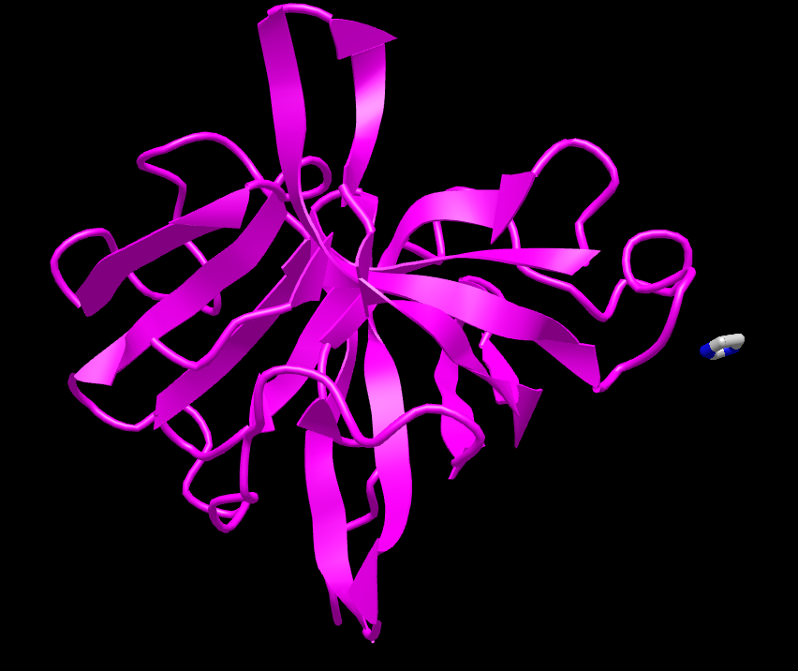
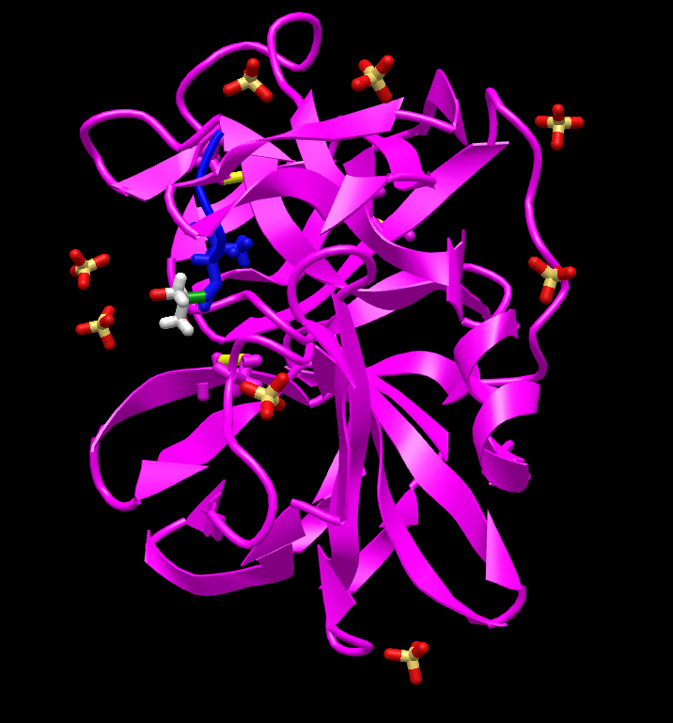
Example: 1ZJD-A
4X2V-A
2H5D-A
…

Slide 4
Amount of Data
96 proteins searchable in PA clan
≈ 100 nearest neighbors on average per protein
Est. ≈ 9600 (upper bound) total proteins in the final dataset

Slide 5
Next steps
Combine all CSVs into one
Send list to Joey for Dali querying?

